Slide 1

Chapter 25
Assisting Special Rescue Teams

Slide 2
Knowledge Objectives
Define the types of special rescues encountered by fire fighters.
Describe the steps of a special rescue.
Explain how tools and equipment are staged for rapid access.
Describe the general procedures at a special rescue scene.
Describe how to safely approach and assist at a vehicle or machinery rescue incident.
Notes:
2

Slide 3
Knowledge Objectives
Describe how to safely approach and assist at a vehicle or machinery rescue incident.
Describe how to safely approach and assist at a confined-space rescue incident.
List the types of incidents that might require a rope rescue.
Describe how to safely approach and assist at a rope rescue incident.
Notes:
3

Slide 4
Knowledge Objectives
Describe the hardware components used during a rope rescue.
Describe how to approach and safely assist at a trench and excavation rescue incident.
Describe how to approach and safely assist at a structural collapse rescue incident.
Describe how to approach and safely assist at a water or ice rescue incident.
Notes:
4

Slide 5
Knowledge Objectives
Describe how to approach and safely assist at a wilderness search and rescue incident.
Describe how to approach and safely assist at a hazardous materials rescue incident.
Describe how to respond safely to an elevator or escalator rescue.
Describe how to safely assist at an active shooter incident.
Notes:
5

Slide 6
Knowledge Objectives
Describe the types of generators used to power lighting equipment.
Describe how generators operate.
Describe how to clean and maintain lighting equipment.
Describe how to maintain generators.
Describe how to maintain power equipment and power tools.
Notes:
6

Slide 7
Skills Objectives
Establish a barrier.
Identify and retrieve rescue tools.
Conduct a weekly/monthly generator test.

Slide 8
Introduction
Fire departments have taken on added roles as the number of fires and amount of loss from fire have decreased.
Emergency medical services
Hazardous materials response
Technical rescue responses
Notes:
8

Slide 9
Introduction
A technical rescue incident (TRI) involves:
Vehicles or machinery
Elevators or escalators
Rope techniques
Water or ice
Trench or structural collapse
Energized electrical equipment
Confined-space rescues
Below-grade rescues
Wilderness search and rescue (SAR)
Hazardous materials
Notes:
9

Slide 10
Introduction
Specialized training is required for true TRI proficiency
Training in TRI is conducted at three levels:
Awareness
Operations
Technician
Most of the training for beginning fire fighters is aimed at the awareness level.
Notes:
10

Slide 11
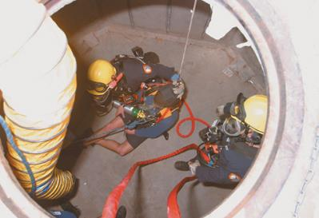
Types of Rescues
Utility hazard incidents
Machinery and vehicle rescue
Confined-space rescue
Rope rescue
Trench and excavation collapse rescue
Structural collapse rescue
© Jones & Bartlett Learning
Notes:
11

Slide 12
Types of Rescues
Cave and tunnel search and rescue
Water and ice rescue
Wilderness search and rescue
Hazardous materials incidents
Elevator and escalator emergencies
Industrial accidents
Active shooter incidents
Notes:
12

Slide 13
Types of Rescues
To become proficient in handling these situations, you must take a formal course to gain specialized knowledge and skills.
It is important for awareness level responders to have an understanding of these special types of rescues and recognize many of the tools needed for rescue situations.
Be sure to train with your department’s special rescue teams.
Notes:
13

Slide 14
Guidelines for Operations
When assisting rescue team members, follow five guidelines:
Be safe.
Follow orders.
Work as a team.
Think.
Follow the Golden Rule of public service.
Notes:
14

Slide 15
Be Safe
Look for hidden hazards.
Have the knowledge and training to recognize a situation as hazardous.
Determine the necessary actions to ensure the safety of yourself, your team members, victims of the incident, and bystanders.
Notes:
15

Slide 16
Follow Orders
Your officers and the rescue teams have received extensive training.
It is critical that you follow orders exactly as they are given.
If you do not know what is expected, ask.
Grasping paramilitary attitudes will facilitate understanding of the command and control aspect of fire departments.
Notes:
16

Slide 17
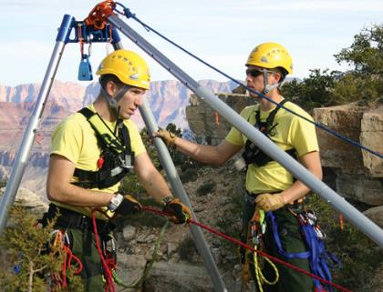
Work as a Team
Team members must work together to complete the goal.
Rescue is a different goal but requires the same team effort.
Your role is essential.
© Jones & Bartlett Learning
Notes:
17

Slide 18
Think
Constantly assess and reassess the scene.
Observations a fire fighter should bring to a superior officer’s attention include:
Unsafe structures
Changing weather conditions
Suspicious packages
Broken equipment
Notes:
18

Slide 19
Follow the Golden Rule of Public Service
Remember that the victim needs your emotional support and encouragement.
It is helpful to tell the victim what actions will be performed during the rescue process.
Notes:
19

Slide 20
Steps of Special Rescue
Preparation
Response
Arrival and size-up
Stabilization
Access
Disentanglement
Removal
Transport
Security of the scene and preparation for the next call
Postincident analysis
Notes:
20

Slide 21
Preparing for the Response
Train with specialized rescue teams.
Know the terms used in the field.
Know the hazards in your response area.
Before responding, address:
Whether department is equipped to do so
Whether department meets National Fire Protection Association (NFPA) and Occupational Safety and Health Administration (OSHA) standards for TRI calls
Which equipment and personnel is sent
How department will respond
Notes:
21

Slide 22
Responding to the Incident
A TRI should have a dispatch protocol.
Agency with own TRI team
Responds with rescue squad
Agency without TRI team
Authority with jurisdiction should arrange for necessary resources and personnel
Often necessary to notify power and utility companies
Notes:
22

Slide 23
Arrival and Size-Up
First company officer assumes command.
Officer should make contact with responsible party at work sites or industrial facilities.
The most important part of any rescue is
Identification of hazards
Decision of recovery versus rescue
Notes:
23

Slide 24
Arrival and Size-Up
Do not rush into the incident.
Stop and think about possible/invisible dangers.
Do not make yourself part of the problem.
Report size-up information, request appropriate resources, and establish a safe perimeter.
When the special rescue team arrives, give updated information and await instructions.
Notes:
24

Slide 25
Tool Staging
Identify the tools and equipment needed.
Place a tarp or salvage cover on the ground at a designated location.
Saves valuable time
Department’s standard operating procedures (SOPs) usually specify the types of tools and equipment to be staged.
The tool staging area can be located outside the building or at a convenient location inside the structure.

Slide 26
Stabilizing the Incident
Once resources are on the way and the scene is safe to enter:
An outer perimeter is established to keep out media and the public (cold zone).
A smaller perimeter is set up around the rescue (warm and hot zones).
Rescue area surrounds the incident site.
Notes:
26

Slide 27
Stabilizing the Incident
Hot zone
For entry teams and rescue teams only
Warm zone
For properly trained and equipped personnel
Cold zone
For staging vehicles and equipment
Notes:
27

Slide 28
Stabilizing the Incident
Zones should be established by identifying and evaluating hazards at the scene.
Observe the geographical area.
Note the routes of access and exit.
Observe weather and wind conditions.
Consider evacuation problems and transport distances.
Once zones are established, ensure that they are enforced.
Notes:
28

Slide 29
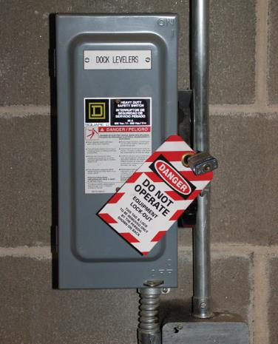
Stabilizing the Incident
Lockout/tagout systems should be used to secure a safe environment.
Be alert for electrical hazards.
© Jones & Bartlett Learning
Notes:
29

Slide 30
Stabilizing the Incident
During stabilization, atmospheric monitoring should also be started to identify any immediately dangerous to life or health (IDLH) environments for rescuers and victims.
The next steps involve looking at the type of incident and planning on how to rescue victims safely.
Notes:
30

Slide 31
Gaining Access to the Victim
Communicate with victim at all times during rescue.
Initiate emergency medical care as soon as access is made to the victim.
Technical rescue paramedics require access to the victim.
Access strategy depends on the type of incident.
May have to be changed during the rescue
Notes:
31

Slide 32
Disentangling the Victim
Free victim as quickly and safely as possible.
A team member should remain with the victim to direct rescuers during disentanglement.
In vehicle collisions, remember that the vehicle should be removed from around the victim, rather than trying to remove the victim through the wreckage.
Notes:
32

Slide 33
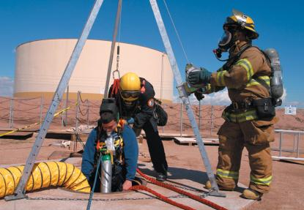
Removing the Victim
“Packaging” is preparing the victim for movement as a unit.
The overriding objective is to complete the process as safely and efficiently as possible.
© Jones & Bartlett Learning
Notes:
33

Slide 34
Transporting the Victim
Remove victim from hazard area.
Transport to proper medical facility.
Type of transport will depend on the severity of the injuries and the distance to the nearest medical facility.
Decontamination must occur before transport.
Notify receiving hospitals.
Address rehabilitation needs of rescue personnel.
Notes:
34

Slide 35
Postincident Duties
Secure the scene and prepare for next call.
Fully inventory, clean, service, and maintain all equipment.
Record keeping
Ensures continuity of quality care
Guarantees proper transfer of responsibility
Fulfills local, state, and federal reporting requirements
Can be used to evaluate areas of interest
Notes:
35

Slide 36
Postincident Analysis
Identify any strengths and weaknesses.
What did you do well?
What could have been done better?
What equipment would have made the rescue safer or easier?
If a death or serious injury occurred during the call, a critical incident stress management session may occur to assist fire fighters.

Slide 37
General Rescue Scene Procedures
Evaluate situation before approaching victim or accident area.
Consider hazards
Utilities
Hazardous materials
Confined spaces
Environmental conditions
IDLH hazards
Notes:
37

Slide 38
Approaching the Scene
Compile facts and factors about the call.
Gain size-up information.
Information received in an emergency call is important to overall success of the rescue operation.
Notes:
38

Slide 39
Approaching the Scene
Information received in an emergency call
Location of incident
Nature of incident
Condition and position of victims, vehicles, building, structure, terrain
Number of victims and types of injuries
Any specific or special hazard information
Name and number of person calling
Notes:
39

Slide 40
Approaching the Scene
A size-up should include
Scope and magnitude of the incident
Risk-benefit analysis
Hazards
Access to the scene
Environmental factors
Available and necessary resources
Establishment of control perimeter
Notes:
40

Slide 41
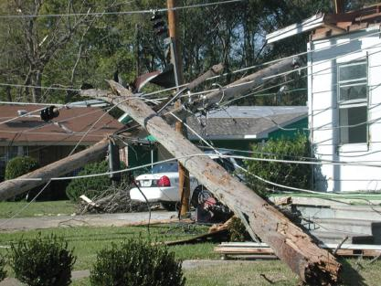
Mitigating Utility Hazards
Look for downed electrical wires.
Incident commander (IC) should ensure that proper procedures have been taken to shut off utilities.
Assume hazards are present until utilities are disconnected.
Courtesy of Lara Shane/FEMA Photo News
Notes:
41

Slide 42
Mitigating Utility Hazards
For electrical hazards
Do not rush to assist victims.
Park at least one truck span away.
Do not touch any wires, power lines, or other electrical sources until they have been de-energized by the power company.
It is not just the wires that are hazardous; any metal that they touch is also energized.
Use proper lockout/tagout procedures.
Notes:
42

Slide 43
Mitigating Utility Hazards
Both natural gas and liquefied petroleum gas are nontoxic but classified as asphyxiants.
They displace breathing air.
Both are flammable.
Call the gas company.
Take appropriate measures if a victim has been overcome by leaking gas.
Notes:
43

Slide 44
Providing Scene Security
IC should coordinate with law enforcement to secure and control the scene.
Maintain a strict personnel accountability system to control access to the rescue scene.
You will often be asked to establish barriers to provide scene security.
Notes:
44

Slide 45
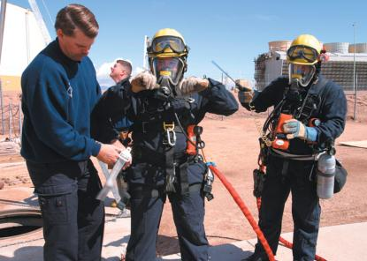
Using Protective Equipment
Most firefighting gear does not work well in a TRI.
Most specialist teams carry harnesses; small, light helmets; and jumpsuits, which are easier to move in.
© Jones & Bartlett Learning
Notes:
45

Slide 46
Protective Equipment in a Water Rescue Hazard Zone
Coast Guard–approved personal flotation device (PFD)
Thermal protection
Helmet appropriate for water rescue
Cutting device
Whistle that works in water
Contamination protection

Slide 47
Other Protective Equipment
Binoculars
Chalk or spray paint for marking searched areas
Compass for wilderness rescues
First aid kits
Whistle
Hand-held global positioning system
Cyalume-type light sticks

Slide 48
Using the ICS
The first arriving officer immediately assumes command and starts using the incident command system (ICS).
Many TRIs will eventually become very complex and require many assisting units.
Without the ICS, it will be nearly impossible to ensure effective scene operations and rescuer safety.
Notes:
48

Slide 49
Ensuring Accountability
Practiced at all emergencies
Ensures safety
Tracks personnel on scene
Identities
Assignment
Location
Notes:
49

Slide 50
Making Victim Contact
Attempt to communicate with victim.
Reassure victim of his or her safety.
Make and keep eye contact with the victim.
Tell the truth.
Communicate at a level the victim can understand.
Be aware of your own body language.
Use the victim’s name.
Always speak slowly, clearly, and distinctly.
Notes:
50

Slide 51
Making Victim Contact
Many victims require medical care.
Medical care should be given only if it can be done so safely.
Do not become a victim during a rescue attempt.
Notes:
51

Slide 52
Assisting Rescue Crews
Train with rescue teams.
Follow the orders of the company officer who receives direction from the IC.
Three factors apply to all scenes:
Approach cautiously.
Position apparatus properly.
Assist specialized team as needed.
Notes:
52

Slide 53
Vehicles and Machinery
Motorcycles
Trucks
Buses
Trains
Mass-transit vehicles
Aircraft
Watercraft
Farm machinery
Agriculture implements
Construction machinery
Industrial machinery
Notes:
53

Slide 54
Vehicles and Machinery: Safe Approach
Hazards include flammable liquids, electrical hazards, and unstable machines or vehicles
Make sure that traffic has been controlled.
Placement of the apparatus is key.
An approved vest must be worn to increase visibility and prevent injuries
Make sure that the machine cannot move.
Access to some victims will not be easy.
Be wary of fuels and fluids spilled at scenes.
Notes:
54

Slide 55
Vehicles and Machinery: How You Can Assist
Protect the victim.
Help support hydraulic tools while technicians operate them.
Assist with controlling site security and the perimeter of the rescue incident.
Obtain information from witnesses.
Retrieve more rescue tools and equipment from the fire apparatus or rescue trucks.
Console a family member of a victim.
Notes:
55

Slide 56
Vehicles and Machinery: How You Can Assist
Keep bystanders out of the way.
Assist in moving items that are in the way of the rescue team.
Service equipment.
Set up power tools.
Stand by with a hose line.
Extinguish a fire.
Notes:
56

Slide 57
Vehicles and Machinery: Tools Used
Personal protective equipment (PPE)
Hydraulic tools
Halligan tool
Cutting torch
Air chisels
Cribbing
Saber saw
Windshield cutter
Spring-loaded punch
Chains
Rescue-lift air bags self-contained breathing apparatus (SCBA) air cylinders
Basic hand tools
Come alongs
Portable generator
Seat belt cutters
Hand lights and other scene lighting
Hose lines
Blanket
Notes:
57

Slide 58
Confined-Space Rescue
Enclosed area that is not designed for people to occupy
Have limited openings for entrance and exit or limited ventilation
Present a special hazard because they may be oxygen deficient, contain poisonous gases, or have combustible atmospheres
Also the potential for slips, trips, falls, entrapment, deep water, and collapse
Notes:
58

Slide 59
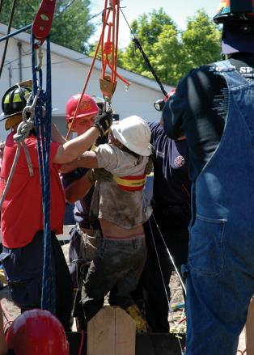
Confined-Space Rescue
Ropes are often used to remove an injured or unconscious victim.
All confined spaces should be considered to be IDLH until proven otherwise.
© Jones & Bartlett Learning. Photographed by Glen E. Ellman.
Notes:
59

Slide 60
Confined-Space Rescue: Safe Approach
Look for a bystander who might have witnessed the emergency.
Information gathered before the technical rescue team’s arrival will save valuable time.
Always assume that there is an IDLH atmosphere at any confined-space call.
The victim of the original incident may have died before your arrival.
Do not put your life in danger for a body recovery.
Notes:
60

Slide 61
Confined-Space Rescue: How You Can Assist
Main role is to secure the scene.
All information should be relayed to the special rescue team members on their arrival, including
Rescue attempts
Exposures
Hazards
Extinguishment of fires
Progress evaluation
If you do encounter an oxygen-deficient atmosphere, set up a ventilation fan.
Notes:
61

Slide 62
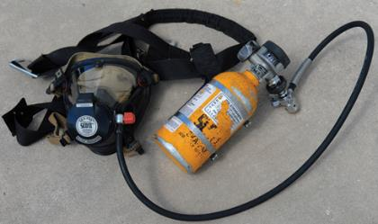
Confined-Space Rescue: Tools Used
One of the key components of any confined-space rescue is a supplied air respirator system.
Provides air that is not limited by air cylinder
© Jones & Bartlett Learning. Photographed by Glen E. Ellman.
Notes:
62

Slide 63
Confined-Space Rescue: Tools Used
Air lines
Air carts
Tripod and winch
Pry bar
Rescue rope
Personnel harnesses
Gas monitors
Ventilation fans
Explosion-proof lights
Radios
Communications equipment
Protective gear

Slide 64
Confined-Space Rescue: Tools Used
Lockout and tagout kits
Personnel accountability boards
Victim removal devices
Medical equipment
Carabiners and locking D rings
Descenders
Safety goggles
Hand lights (battery-operated)
Hearing protection headsets

Slide 65
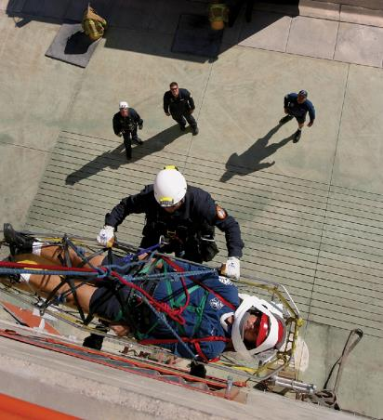
Rope Rescue
Rope rescue skills may be used in a variety of incidents.
Approved ropes course is required to attain true proficiency.
© Jones & Bartlett Learning. Photographed by Glen E. Ellman.
Notes:
65

Slide 66
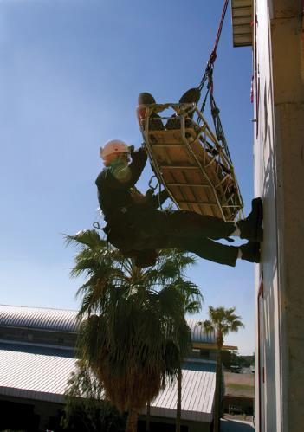
Rope Rescue
Most incidents involve people trapped in normally inaccessible locations
Extreme cases could involve complicated operations.
© Jones & Bartlett Learning. Photographed by Glen E. Ellman.
Notes:
66

Slide 67
Rope Rescue
The number and type of ropes used depend on the situation.
There is almost always a primary rope that bears the weight of the rescuer.
A second line is often attached (belay line) that serves as a backup.
Additional lines might be needed to raise or lower the victim.
Rope rescue incidents are divided into low-angle and high-angle operations.

Slide 68
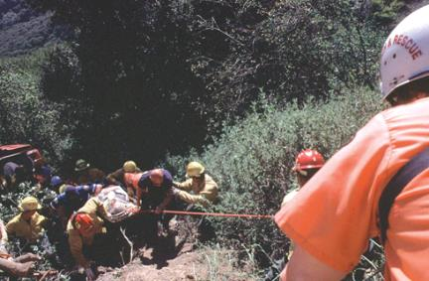
Low-Angle Operations
Situations where the slope of the ground over which the fire fighters are working is less than 45 degrees
Ground is primary support.
Rope system is secondary support.
© Keith D. Cullom/www.fire-image.com

Slide 69
High-Angle Operations
Situations where the slope of the ground is greater than 45 degrees
Rescuers or victims are dependent on life safety rope and not a fixed surface of support, such as the ground.
High-angle rescue techniques are used to raise or lower a person when other means of raising or lowering are not readily available.
There is a lot more to learn before you are ready to perform high-angle rescues.

Slide 70
Rope Rescue: Safe Approach
Among the most time-consuming calls that you will encounter.
Protect your safety by remaining away from the area under the victim and away from any loose materials that may fall.
If you are above the victim, stay back from the edge and do not cause any loose debris to fall onto the victim.
Work to control the scene.

Slide 71
Rope Rescue: How You Can Assist
You may be assigned to tie knots and get anchors ready.
Do not be offended if the team members go back and check your work.
Avoid stepping on ropes.
Keep everyone clear of areas where a falling object could cause injuries.
Follow the ICS.
Work to complete your assigned tasks.

Slide 72
Rope Rescue: Tools Used
PPE (helmet, rescue gloves)
Personnel harnesses
Stokes basket
Harness
Made of webbing and worn by a person
Class II fastens around the rescuer’s waist and legs
Class III is a full-body harness

Slide 73
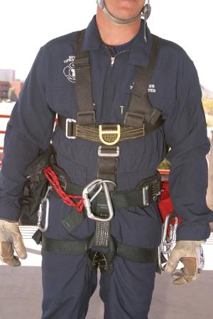
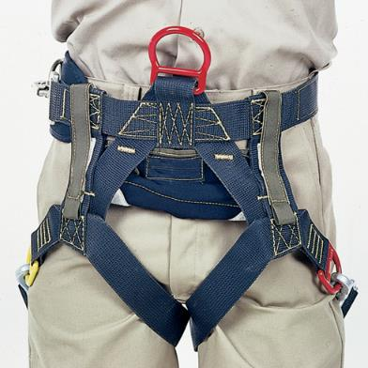
Rope Rescue: Tools Used
© Jones & Bartlett Learning. Photographed by Glen E. Ellman.
Courtesy of RescueTECH1, Inc.

Slide 74
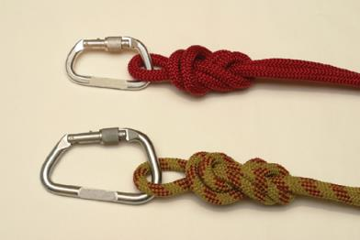
Rope Rescue: Tools Used
Rescue rope
Carabiners
Webbing and prusik cord
Miscellaneous hardware
© Jones & Bartlett Learning. Photographed by Glen E. Ellman.

Slide 75
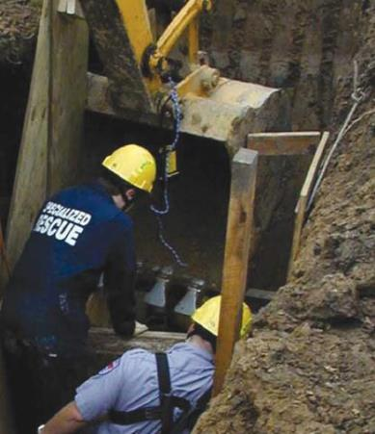
Trench and Excavation Collapse Rescue
Occurs when earth has been removed and sides collapse
Entrapments can occur.
Being near edge can cause further collapsing of sides.
Courtesy of Captain David Jackson, Saginaw Township Fire Department
Notes:
75

Slide 76
Trench and Excavation Collapse Rescue
Vibration or additional weight on top of displaced earth will increase the probability of a secondary collapse.
A secondary collapse is one that occurs after the initial collapse.
It can be caused by equipment vibration, personnel standing at the edge of the trench, or water eroding away the soil.
Notes:
76

Slide 77
Trench and Excavation Collapse Rescue: Safe Approach
Stay away from the edge of the collapse and keep all workers and bystanders away.
Shut off all heavy equipment.
Have traffic stopped or diverted.
Avoid disturbing the spoil pile.
Make verbal contact with the trapped person if possible.
Determine where the victims were last seen.
Notes:
77

Slide 78
Trench and Excavation Collapse Rescue: How You Can Assist
Tasks may range from unloading lumber for shoring to assisting with cutting timbers a safe distance away from the entrapment.
This type of rescue takes a long time. A rehabilitation sector may need to be set up.
Setting up ventilation fans can often make a difference in victim and rescuer survivability.
It may also be necessary to pump water out of a trench.
Notes:
78

Slide 79
Trench and Excavation Collapse Rescue: Tools Used
PPE
Hydraulic, pneumatic, and wood shores
Cribbing
Power cutting tools and saws
Carpentry hand tools
Shovels
Buckets
Rescue rope, harnesses, webbing
Utility rope
Ventilation fans
Water pumps
Lighting
Ladders
Shovels
Extrication equipment
Harness sets
Medical equipment

Slide 80
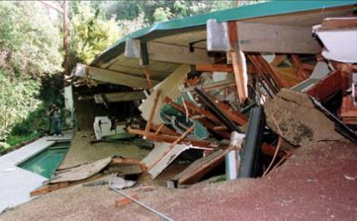
Structural Collapse Rescue
Sudden and unplanned fall of a building
Consider building construction.
Dynamics of building change.
Always be alert for secondary collapse.
Courtesy of Dave Gatley/FEMA.
Notes:
80

Slide 81
Structural Collapse Rescue: Safe Approach
Because of the variety of factors that can cause building collapses, you must approach the scene very carefully.
As you approach a building collapse, consider the need to shut off utilities.
A prime safety consideration is the stability of the building.
IC will decide whether the building is safe to enter.
Notes:
81

Slide 82
Structural Collapse Rescue: How You Can Assist
Rescue operations vary by size of the building and the amount of damage to the building.
In cases of large building collapses, the rescue operation will be sizable.
These types of rescue situations take a lot of time and require a lot of personnel.
There must be teamwork and a well-organized and well-implemented ICS.
Notes:
82

Slide 83
Structural Collapse Rescue: Tools Used
PPE
Shoring equipment
Lumber for shoring and cribbing
Power tools
Hand tools
Lighting
Rescue ropes, harnesses, webbing, and associated hardware
Utility rope
Buckets
Shovels
Notes:
83

Slide 84
Cave and Tunnel Rescue: How You Can Assist
Maintain a safe perimeter around the operations area.
Stage tools and equipment in the designated area.
Assist with patient packaging once the victim is removed.

Slide 85
Cave and Tunnel Rescue: Tools Used
Similar to those used for collapse incidents
PPE
Hydraulic, pneumatic, and wood shores
Lumber and plywood for shoring
Cribbing
Power cutting tools and saws
Carpentry hand tools
Shovels
Buckets for moving soil
Rescue rope, harnesses, webbing
Tripod and winch

Slide 86
Cave and Tunnel Rescue: Tools Used
Gas monitors
Ventilation fans
Explosion-proof lights
Radios
Utility rope
Ventilation fans
Water pumps
Lighting and hand lights
Ladders
Shovels
Extrication equipment
Harness sets
Hearing protection headsets
Medical equipment

Slide 87
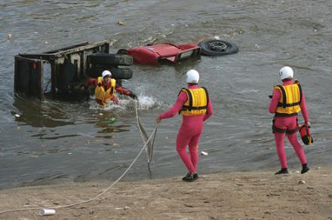
Water and Ice Rescue
Almost all fire departments have the potential to be called to perform a water rescue.
There may be no current or a very swift current.
© Nate Rawner
Notes:
87

Slide 88
Water and Ice Rescue
In North America, the most common swift-water rescue scenario is a car that has tried to drive through a pool of water created by a storm.
Vehicle occupants will be stranded.
Vehicle can be swept away.
Scenario is especially dangerous for rescue personnel.
Notes:
88

Slide 89
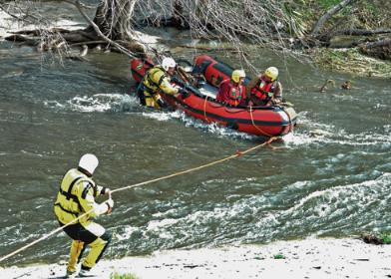
Water and Ice Rescue: Ropes
Simplest use involves a rescuer on shore throwing a rope to a person in the water and pulling him or her to shore.
A more complicated situation could involve a rope stretched across a body of water.
Courtesy of Captain David Jackson, Saginaw Township Fire Department.
Notes:
89

Slide 90
Water and Ice Rescue
Other common rescue scenarios include
Cars rolling into lakes or streams
Cars going off bridges
People falling into bodies of water
Swimmers getting into trouble

Slide 91
Water and Ice Rescue: Safe Approach
Use PPE designed for water rescue, not structural firefighting.
Try to communicate with the victim.
Do not exceed your level of training.
Do not use a boat unless you are trained.
Ensure that bystanders do not try to rescue the victim.
Ice rescues are common in colder climates.
Special ice-rescue suits are needed.

Slide 92
Water and Ice Rescue: How You Can Assist
Do not attempt to go onto the ice to rescue victims without special training and equipment.
PFDs should be used by everyone operating at the scene.
You may be called on to assist by keeping victims in sight, retrieving equipment, assisting with rescue ropes, changing rescuers’ air supplies, or relay communications.
Be alert for changing weather conditions.

Slide 93
Water and Ice Rescue: Tools Used
PFD
Self-contained underwater breathing apparatus (SCUBA)
Helmet
Waterproof whistle
Water rescue throwline
Boat
Rescue rope, webbing, and associated hardware
Lighting and hand lights
Gloves
Goggles or other eye protection
Suitable footwear for the environmental and rescue conditions

Slide 94
Wilderness Search and Rescue
Conducted by a limited number of fire departments
Two categories consist of:
Search is defined as looking for a lost or overdue person.
Rescue, in the SAR context, is defined as removing a victim from a hostile environment.
Notes:
94

Slide 95
Wilderness Search and Rescue: Safe Approach
In cases of a lost person, some small fire departments will request all available personnel to respond to assist with a search.
Respond as part of your department and to work together as a team.
Wilderness can include varied environments.
Prepare for the weather conditions by bringing suitable clothing.
Make sure that you do not exceed your physical limitations.
Notes:
95

Slide 96
Wilderness Search and Rescue: How You Can Assist
Never go out alone. Teams can be methodically deployed and assigned to a search.
The more knowledge you have about the search area, the more vital your role is.
Knowing your response area and the places where a child or lost person might hide is always beneficial to the search.
Do not enter the search area before the search team arrives.
Notes:
96

Slide 97
Wilderness Search and Rescue: Tools Used
Personal clothing appropriate for the environment
Water
Food
Lighting
Communications equipment
Medical equipment
Maps, compass, and GPS
Shelter
Rescue ropes, harnesses, webbing, and associated hardware
Extrication equipment
Signaling devices
Notes:
97

Slide 98
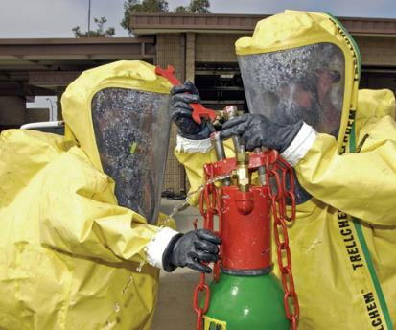
Hazardous Materials Incidents
Hazardous materials: Any material or substance that poses a significant risk to the health and safety of persons or to the environment if it is not properly handled
Courtesy of Photographer’s Mate 2nd Class Daniel R. Mennuto/U.S. Navy.
Notes:
98

Slide 99
Hazardous Materials Incidents
Often involve petroleum products, but there are many other chemicals that have toxic effects when mishandled
Many retail businesses contain hazardous materials.
Most fire departments are trained and equipped to recognize these incidents, contain the hazards, and evacuate people if necessary.
Notes:
99

Slide 100
Hazardous Materials Incidents: Safe Approach
You must be able to recognize that there may be hazardous materials present as you approach the scene.
Have the hazardous materials team dispatched as soon as possible.
In addition to standard actions and precautions,
Implement site control and scene management.
Assist specialized personnel after their arrival according to your training level.
Notes:
100

Slide 101
Hazardous Materials Incidents: How You Can Assist
Training at the awareness level will provide you with the knowledge and skills you need.
Four major objectives of training:
Analyze the magnitude of the hazardous materials incident.
Plan an initial response.
Implement the planned response.
Evaluate the progress of the actions taken to mitigate the incident.

Slide 102
Hazardous Materials Incidents: Tools Used
PPE
Two-way radios
Lighting
Gas monitors
Sensing and monitoring tools
Extensive research material
Decontamination equipment
Wide variety of hand tools
Devices for sealing breached containers
Leak-control devices
Binoculars
Fire line tape
Control agents

Slide 103
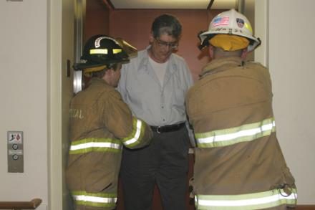
Elevator Rescue
These rescues are increasing in frequency.
Never attempt to move or relocate an elevator under any circumstances.
© Dennis Wetherhold, Jr.

Slide 104
Elevator Rescue
Always shut off power to a malfunctioning elevator and secure the power supply.
Always use the lockout and tagout procedures and post a fire fighter at the power source.
Identify the location of the stalled elevator.
If there are victims, communicate with and reassure them.
Victims are safer inside the elevator.
Once the incident has been resolved, leave the power supply off.

Slide 105
Escalator Rescue
Never attempt to move an escalator under any circumstances.
Good incident risk management and assessment skills are crucial.
Victims must be reassured, calmed, and medically stabilized.
The escalator machinery must be stopped.
Stop switches are located at the top and bottom of most escalators.

Slide 106
Escalator Rescue
Secure the power source.
Ensure that personnel are competently trained and the proper equipment is available.
Unnecessary or excessive damage to the escalator equipment is also undesirable.
The best course may be to take no action until a trained professional arrives.
The machinery may have to be dismantled.
Leave the power supply turned off until after the incident has been resolved.

Slide 107
Industrial Rescue
May involve
Specialized vehicles and equipment
Confined spaces
High-voltage electrical equipment
Hazardous materials
High-angle rescue situations
Preincident planning should include possible rescue incidents.
Train with your special rescue team to be prepared for emergencies at these facilities.

Slide 108
Active Shooter Incidents
Active shooters are defined as one or more individuals actively engaged in harming, killing, or attempting to kill people in a populated area with the use of a firearm.
These incidents occur in buildings where people gather in larger numbers.
NFPA 3000 is a provisional standard that covers these incidents.

Slide 109
Active Shooter Incidents
Any incident involving a hostile event such as an active shooter situation will require the assistance and cooperation of countless local, state, and federal resources.
Think about the locations of potential active shooter targets in your response area.
Maintain good situational awareness.
Consider changing conditions and the possibility of additional shooters or planted explosive devices.

Slide 110
Active Shooter Incidents
Approach reported active shooter situations cautiously and stage a safe distance away until direction is provided by law enforcement.
Don ballistic PPE if provided.
Be prepared to fight fire once the area has been secured.
In mass casualty situations, you may be asked to forego fire suppression to provide immediate rescue/shielding of victims and control bleeding.

Slide 111
Active Shooter Incidents
If you are dispatched to an incident and discover an active shooter, take immediate action.
Take cover behind any object that provides protection.
Request immediate assistance.
The goal is to help victims and the uninjured retreat to safety.
Always follow your local protocols.

Slide 112
Power Tools and Equipment
Used for lighting, ventilation, salvage, and overhaul
You may be responsible for cleaning, maintaining, and testing this equipment.
Use these items only after you have received training in their use.
Read and follow the instructions supplied by the manufacturer.

Slide 113
Lighting Equipment and Electrical Generators
Powerful lighting equipment requires a separate source of electricity, supplied by
Generator
Inverter
Building’s electrical system

Slide 114
Power Inverters
Convert 12-volt DC from a vehicle’s electrical system to 120-volt AC power.
Typically used to power one or two apparatus-mounted lights
Most do not produce enough power to operate high-intensity lighting equipment, large power tools, or ventilation fans.
Be aware that drawing too much power can seriously damage an inverter.

Slide 115
Electrical Generators
Powered by gasoline or diesel engines
Portable generators
Come in various sizes
Can produce as much as 6 kW of power
Has its own fuel tank
Apparatus-mounted generators
Sometimes exceed 20 kW
Draw fuel directly from the vehicle’s fuel tank
Can also be powered by the apparatus engine

Slide 116
Building Power Supply
Usually not an option if serious fire has occurred because the power will be disconnected
Power can sometimes be obtained from a nearby building.
Do not overload a household electrical circuit.

Slide 117
Cleaning and Maintenance of Electrical Equipment
Follow the manufacturer’s instructions for cleaning.
Clean with a mild soap or detergent.
Avoid strong solvents.
Avoid overfilling the fuel tank on portable generators.
Test generators on a weekly or monthly basis.
Run generators for 15 to 30 minutes to reduce any deposit build-up.
Inspect and test any other electrical equipment.

Slide 118
Power Tools and Equipment
Heavy machinery
Hand tools
Powered tools
Hydraulic rams and spreaders
Power tools for cutting or severing
Air chisels powered by pressurized air
Powered saws

Slide 119
Cleaning and Maintenance of Power Tools and Equipment
Test these items frequently and have them serviced regularly by a qualified shop.
Keep records of all inspection and maintenance.
Fill each tool with the proper fuel.
It may be necessary to drain and refill equipment with fresh fuel.
Check manufacturer’s recommendations.

Slide 120
Cleaning and Maintenance of Power Tools and Equipment
After returning from a fire, clean, inspect, and record data for all of your overhaul tools.
All debris should be removed, and the tools should be clean and dry.
All fuel tanks should be filled completely with fresh fuel.
Any dull or damaged blades and chains should be replaced.
Belts should be inspected to ensure that they are tight and undamaged.

Slide 121
Cleaning and Maintenance of Power Tools and Equipment
All guards should be securely in place.
All hydraulic hose should be cleaned and inspected.
All power cords should be inspected for damage.
All hose fittings should be cleaned, inspected, and tested to ensure a tight fit.
Tools should be started to ensure that they operate properly.

Slide 122
Cleaning and Maintenance of Power Tools and Equipment
Tanks on water vacuums should be emptied, washed, cleaned, and dried.
The hose and nozzles on wet vacuums should be cleaned and dried.
Keep all manufacturers’ manuals in a safe and easily accessible location.
Learn the proper procedure for reporting a problem with a power tool and taking it out of service.

Slide 123
Summary
A TRI is a complex rescue incident involving vehicles or machinery, water or ice, rope techniques, trench or excavation collapse, confined spaces, structural collapse, cave and tunnel rescue, wilderness rescue, utility hazards, or hazardous materials that requires specially trained personnel and equipment.
Training in technical rescue areas is conducted at three levels: awareness, operations, and technician

Slide 124
Summary
To become proficient in handling these types of situations, you must take a formal course to gain specialized knowledge and skills.
Tool staging often involves placing a tarp or salvage cover on the ground at a designated location and laying out commonly used tools and equipment so that they can be readily accessed.

Slide 125
Summary
During technical rescue incidents, several hardware components—in addition to rope—are used to rescue victims. Two common components are carabiners and harnesses.
Most rope rescue incidents involve people who are trapped in normally inaccessible locations such as trenches, confined spaces, and open water.

Slide 126
Summary
When assisting rescue team members, keep five guidelines in mind:
Be safe.
Follow orders.
Work as a team.
Think.
Follow the Golden Rule of public service: Treat others as you would like to be treated.

Slide 127
Summary
The basic steps of special rescue operations are:
Preparation
Response
Arrival and size-up
Stabilization
Access
Disentanglement
Removal
Transport
Security of the scene
Preparation for the next call
Postincident analysis

Slide 128
Summary
Beginning with the initial dispatch of the rescue call, start compiling facts and identifying factors pertinent to the call. The information acquired when an emergency call is received is important to the success of the rescue operation, including:
Nature and location of the incident
The conditions and positions of victims and vehicles
Any specific or special hazard information

Slide 129
Summary
A size-up should include the initial and continuous evaluation of the following issues:
Scope and magnitude of the incident
Risk/benefit analysis
Number of known and potential victims
Hazards
Access to the scene
Environmental factors
Available and necessary resources
Establishment of control perimeters

Slide 130
Summary
After sizing up the scene, take the following precautions:
Secure utility hazards.
Provide scene security.
Use the proper protective equipment for the emergency.
Activate ICS.
Activate the personnel accountability system.
Make contact with the victim, and keep the victim calm.

Slide 131
Summary
At any type of TRI, follow the orders of the company officer who receives direction from the IC. Many of the tasks assigned to fire fighters will involve moving equipment and objects from one place to another; others will involve protecting the team and victims.
Vehicle and machinery rescues occur in many settings. These situations require responders to stabilize the machinery and ensure that the electricity is off.

Slide 132
Summary
With a confined space, rescuers must ensure that a pure and adequate air supply is available before entering the confined spaces.
Low-angle and high-angle rope rescues require safe equipment, adequate training, and considerable caution.
Trench and excavation rescues are hazardous and require responders to minimize the chance for secondary collapses.

Slide 133
Summary
A damaged building is prone to structural collapse. When any part of a building becomes compromised, the dynamics of the building change.
Water rescue training is needed in almost all communities. Training, proper PFDs, and appropriate clothing are important to ensure rescuer safety. Wilderness rescue may be called for even when initial access to a lost or stranded individual occurs quickly.

Slide 134
Summary
Hazardous materials incidents are not always dispatched as hazardous materials incidents, so be cautious when approaching any incident.
Never attempt to move or relocate an elevator under any circumstances. Always shut off the power to a malfunctioning elevator, and secure the power supply. Implement incident risk management and risk assessment. Once the incident has been resolved, leave the power supply off.

Slide 135
Summary
Escalator emergencies can be challenging and complex. Never attempt to move an escalator under any circumstances—only professional escalator technicians who are thoroughly trained and authorized to do so should consider this step.
Electricity for lighting equipment is supplied by a generator, an inverter, or a building’s electrical system, if the power has not been interrupted.

Slide 136
Summary
An inverter can provide a limited amount of AC current and is typically used to power one or two lights mounted directly on the apparatus.
Electrical generators are powered by gasoline or diesel engines; they can be either portable or permanently mounted on fire apparatus.

Slide 137
Summary
Portable electrical equipment should be cleaned and properly maintained to ensure that it will work when needed. Test and run generators on a weekly or monthly basis to confirm that they will start, run smoothly, and produce power. Run gasoline-powered generators for 15 to 30 minutes to reduce any deposit build-up that could foul the spark plugs and make the generator hard to start.

Slide 138
Summary
All tools and equipment must be properly maintained and left in a “ready state” for immediate use at the next incident:
Equipment should be cleaned, dried, inspected, and stored properly.
Fuel tanks should be filled.
Any dull or damaged blades and chains should be replaced.
Power equipment and tools should be tested and serviced frequently.

Slide 139
Summary
Read and follow the manufacturer’s manuals, and follow all instructions on the care and inspection of power tools and equipment.

